Slide 1
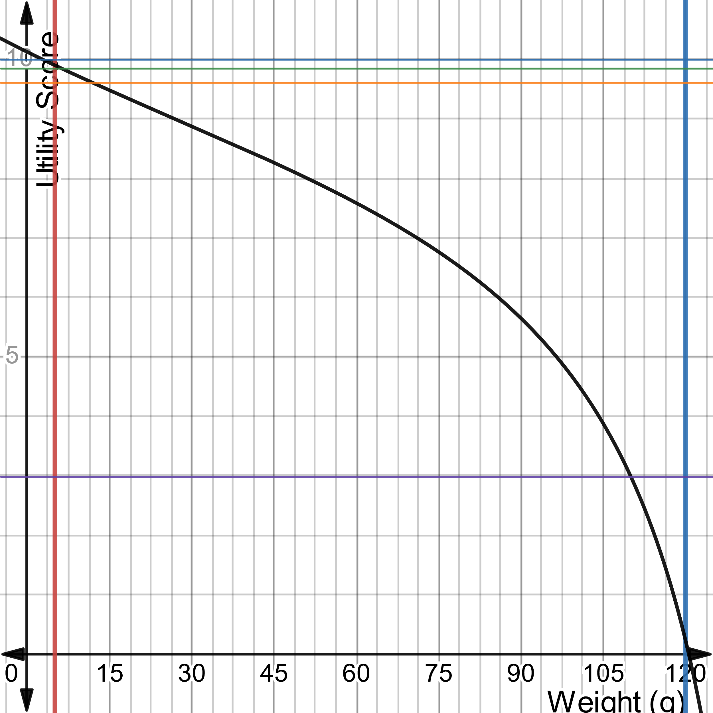




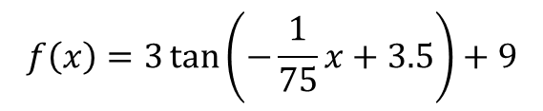
Requirement: The Drone shall utilize proximity sensors with a unit weight less than 120g (T) 5g (O).
Proximity Sensor Weight
$f(5.0)=$10.00
$f(6.5)=$9.83
$f(8.5)=$9.75
Utility Function
$$f\left(x\right)=3\tan\left(−\frac{1}{75}x+3.5\right)+9$$
$f(110)=$2.98

Slide 2
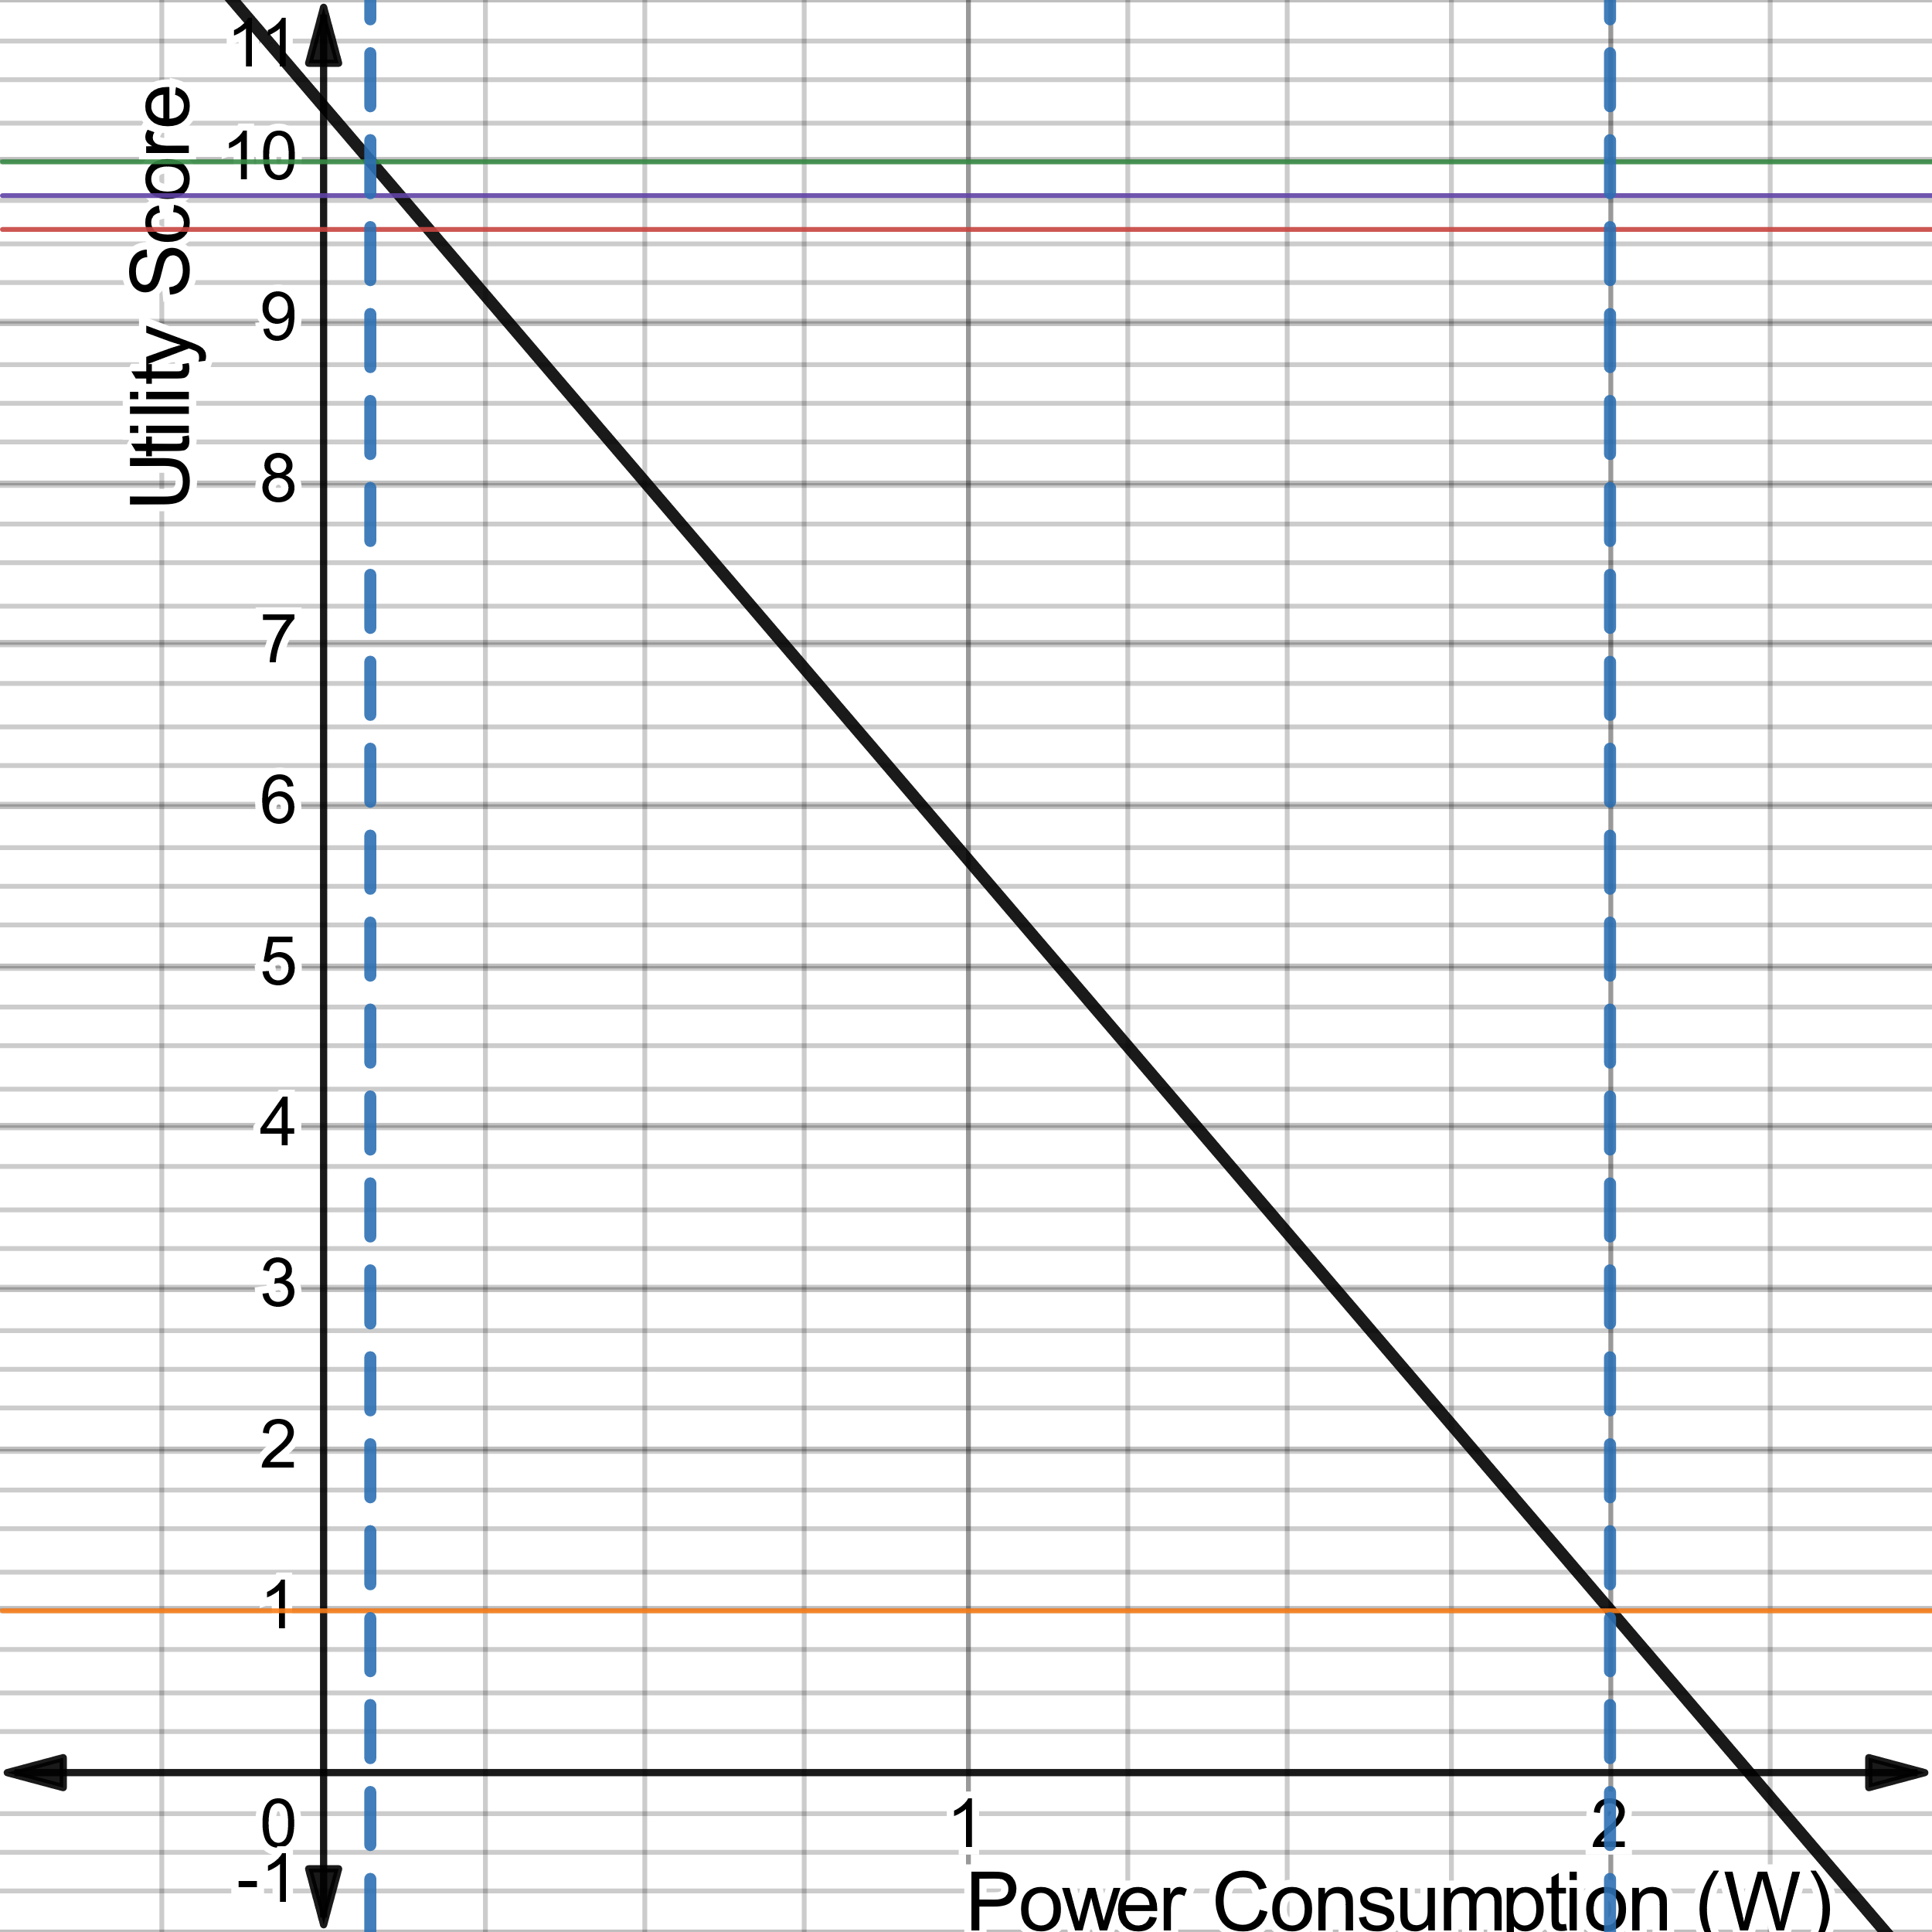





Requirement: The Drone shall utilize proximity sensors with a nominal power consumption of 2W(T) 0.075W(O).
Proximity Sensor Power
$f(0.075)=$10.00
$$f(0.120)=9.78$$
$f(0.165)=$9.58
$$f\left(x\right)=−4.67532x+10.35065$$
Utility Function
$$f(2.000)=1$$

Slide 3
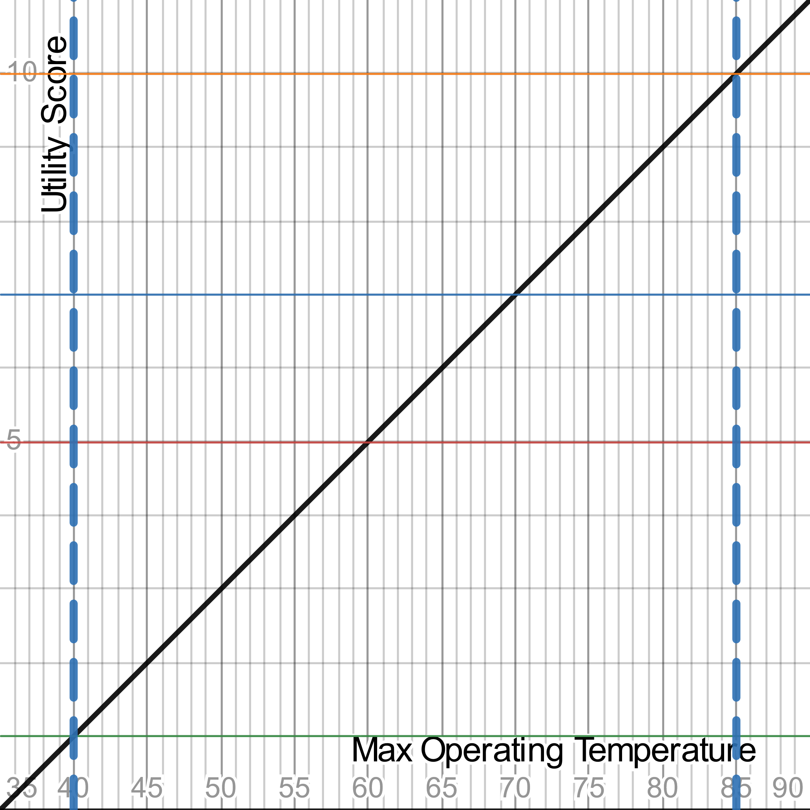





Requirement: The Drone shall utilize proximity sensors with a maximum operating temperature at 40°C (T) 85°C (O).
Utility Function
Proximity Sensor Max Operating Temperature
$f(85)=$10
$$f(x)= \frac{1}{5}x − 7$$
$f(70)=$7
$f(60)=$5
$f(40)=$1

Slide 4
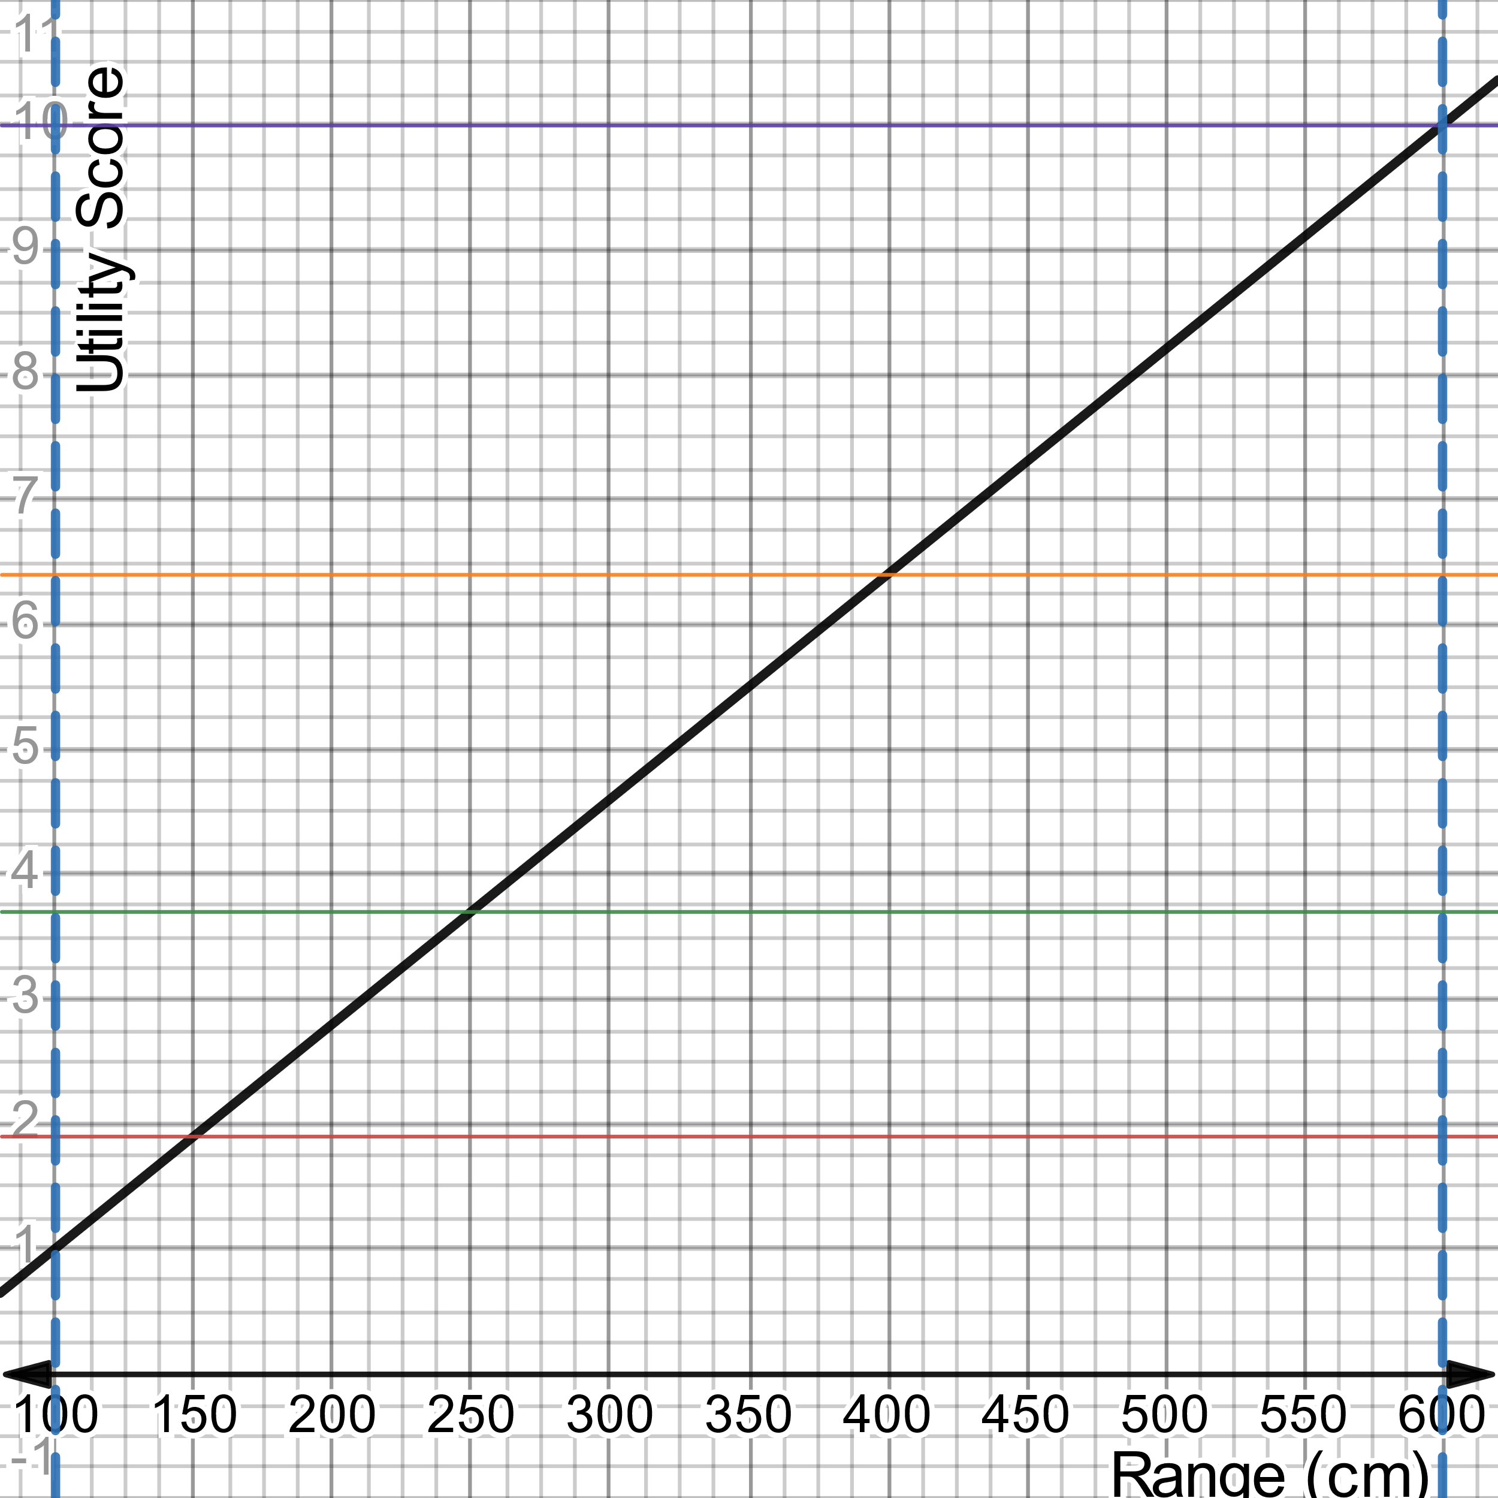





Requirement: The Drone shall utilize proximity sensors with a measurement range of at least 100cm (T) 600cm (O).
Utility Function
Proximity Sensor Range
$f(18500)=$10
$$f\left(x\right)=0.018x−0.8$$
$$f\left(400\right)=6.4$$
$$f(250)=3.7$$
$$f\left(150\right)=1.9$$

Slide 5
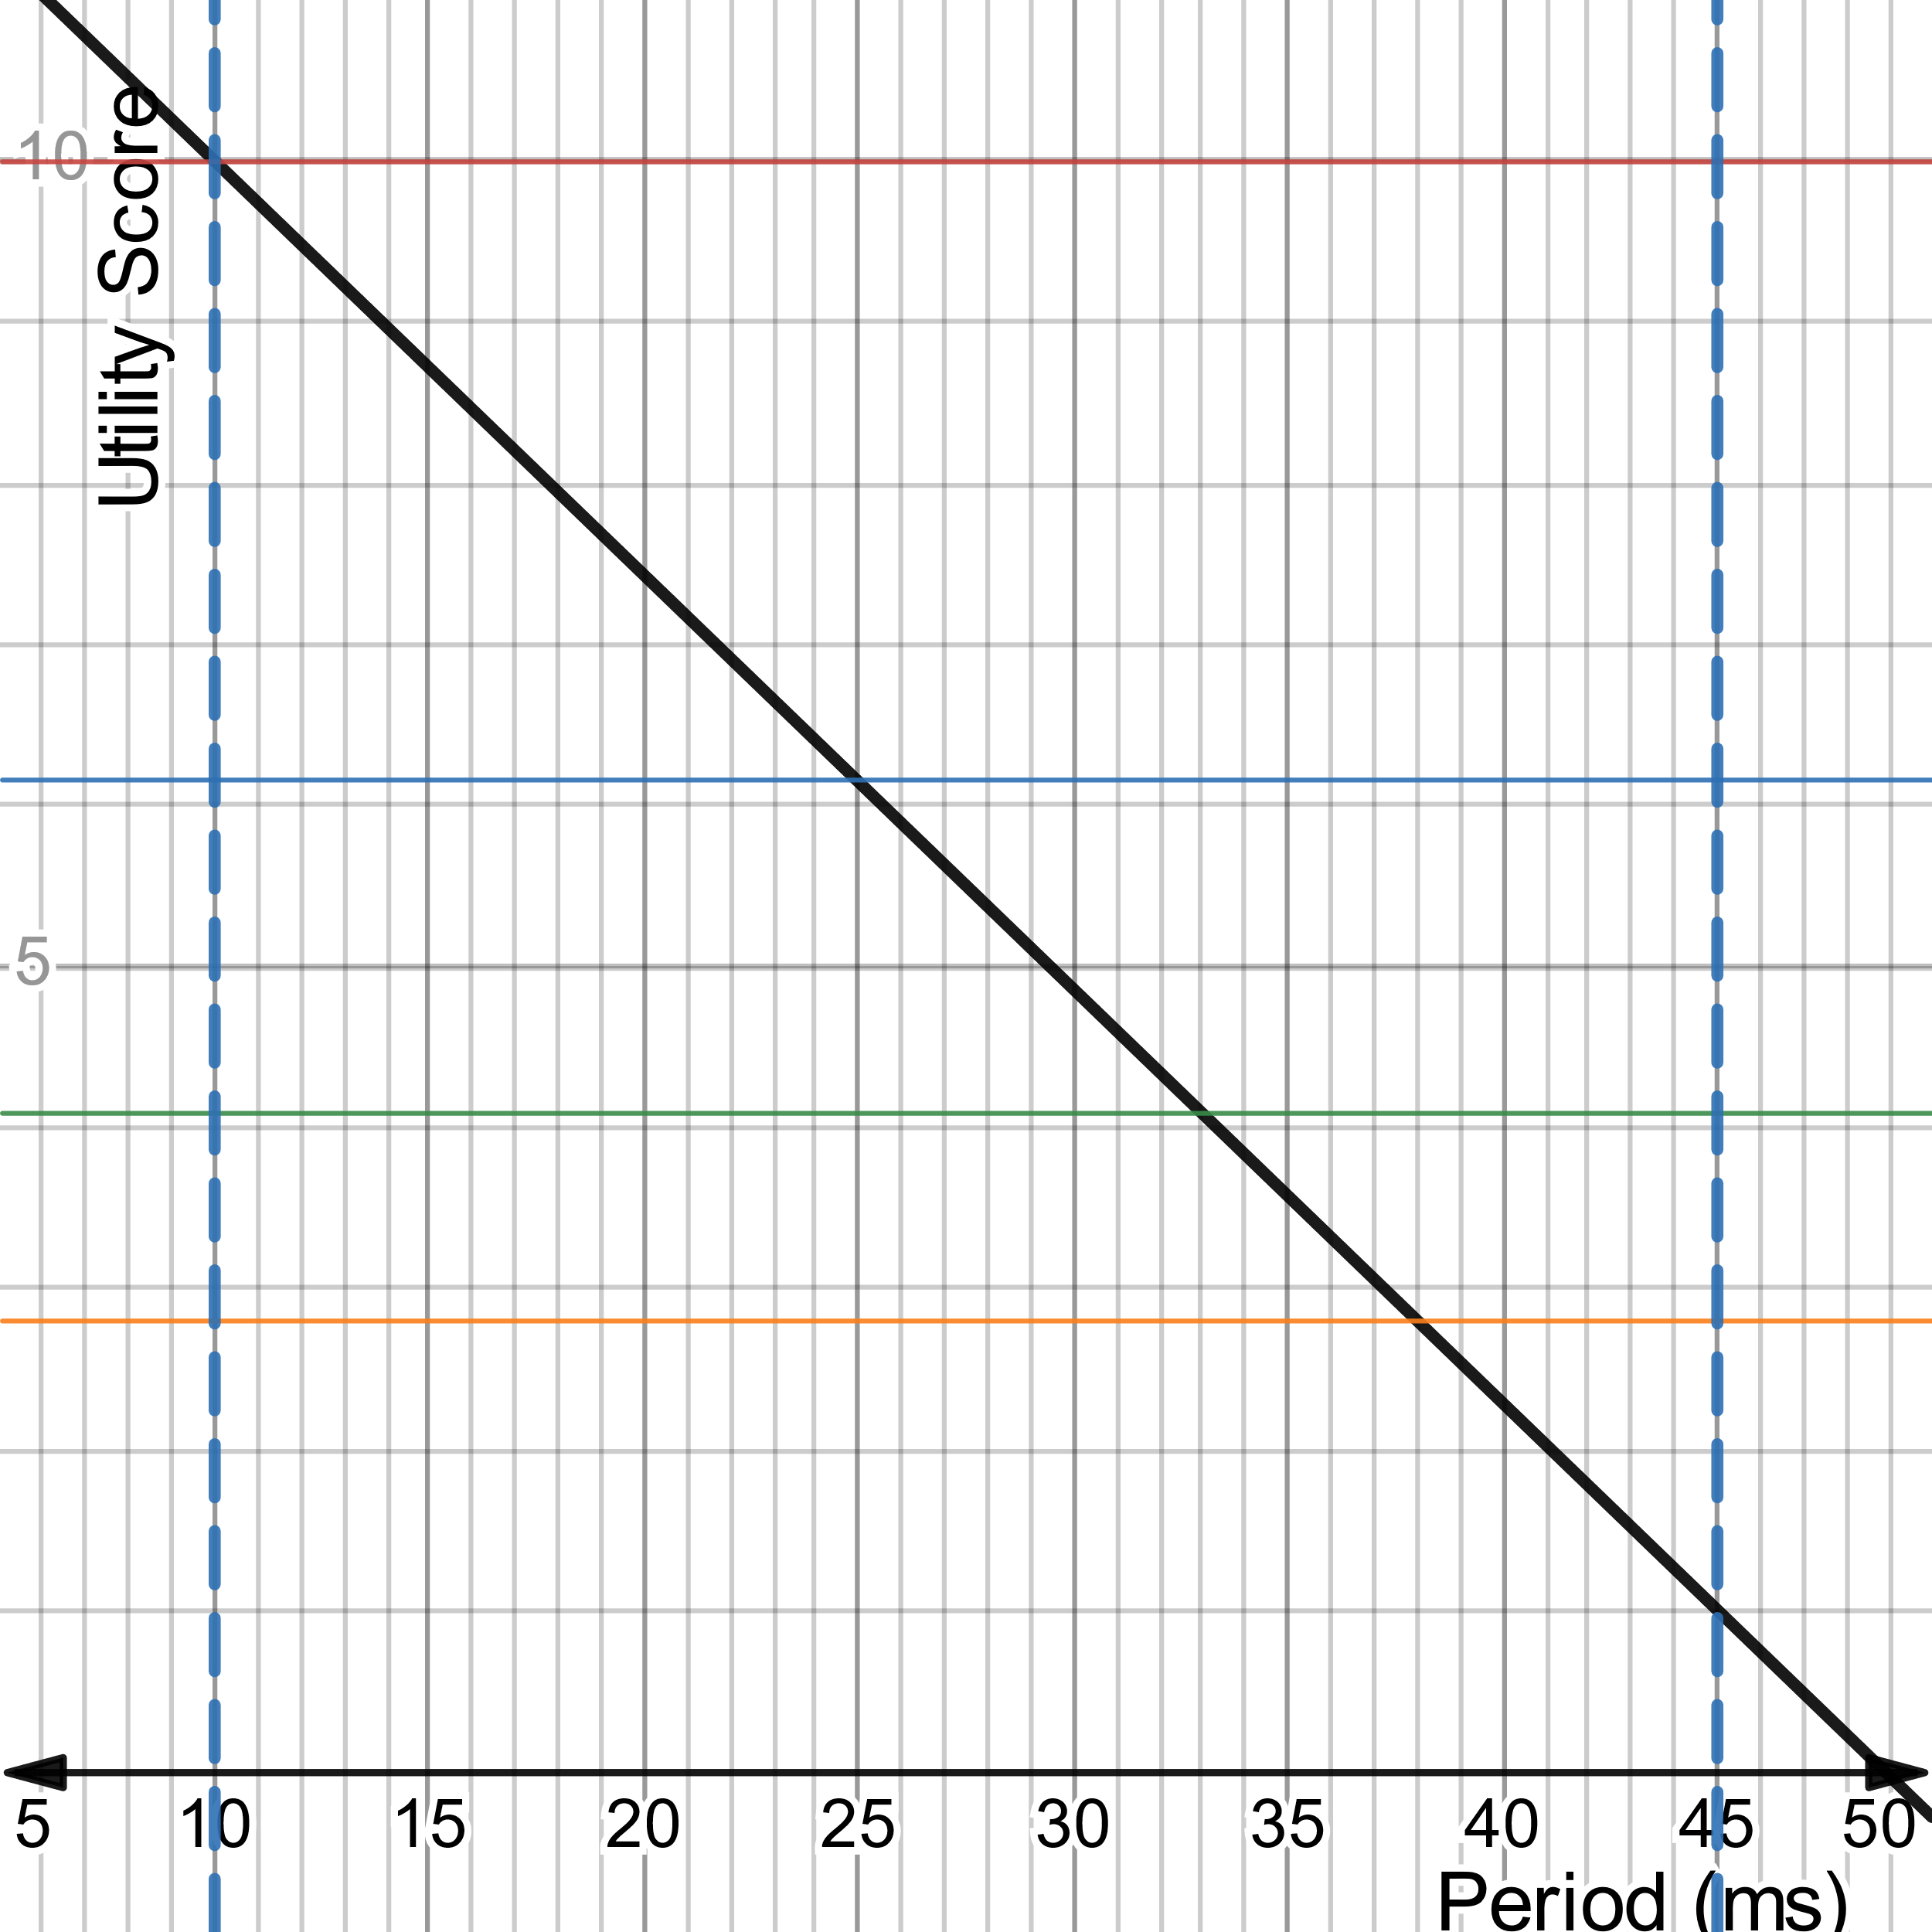





Requirement: The Drone shall utilize proximity sensors with a measurement period of at most 45ms (T) 10ms (O)
Proximity Sensor Measurement Period
$f(10)=$10.00
$$f\left(x\right)=−\frac{9}{35}\left(x\right)+\frac{88}{7}$$
Utility Function
$$f(25)=6.14$$
$$f(33)=4.08$$
$$f\left(38\right)=2.8$$

